Slide 1
Data Refinery
Naresh olladapu
Developer Advocate
IBM Developer
1

Slide 2
What is Data Science?
Data science is the study of data.
It involves developing methods of recording, storing, and analysing data to effectively extract useful information.
The goal of data science is to gain insights and knowledge from any type of data (Structured or Unstructured)

Slide 3
Data Science Process
3

Slide 4
What is Data Refinery?
Consists of –
Cleansing Data - fix or remove data that is incorrect, incomplete, improperly formatted, or duplicated
Shape Data - customize it by filtering, sorting, combining or removing columns, and performing operations
Outcome is creation of customized Data Refinery flow
2

Slide 5
Why is Data Refinery Important?
Dataset needs to be structured and combined from multiple sources.
Dataset might contain discrepancies in the names or the codes.
Dataset might contains outliers or errors.
Dataset lacks your attributes of interest for analysis.
Noisy Datasets can lead to incorrect Insights.
3

Slide 6
Challenges in Data Refinery?
Handle data from Multiple sources (NoSQL, Hadoop, RDMS, Dropbox etc.)
Increase the Compute and storage based on our requirement very easily.
Data refinery process should provide diagnostic and cognitive Analytics.
Scheduling Data refinery process on a real time data streaming from sources like social media , IoT devices etc.
Age old ETL process is slow, time consuming , limits output and performance.
4

Slide 7
Exploring Data Refinery Tool
Adding data to Data Refinery
View your Sample Data set
Specifying the format of the data
Validating the data
Visualizing the data
Managing Data Refinery flows
GUI operations
Scheduling Data Refinery flows
5

Slide 8
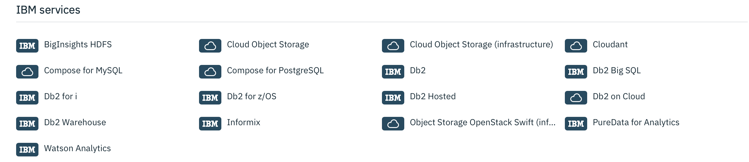
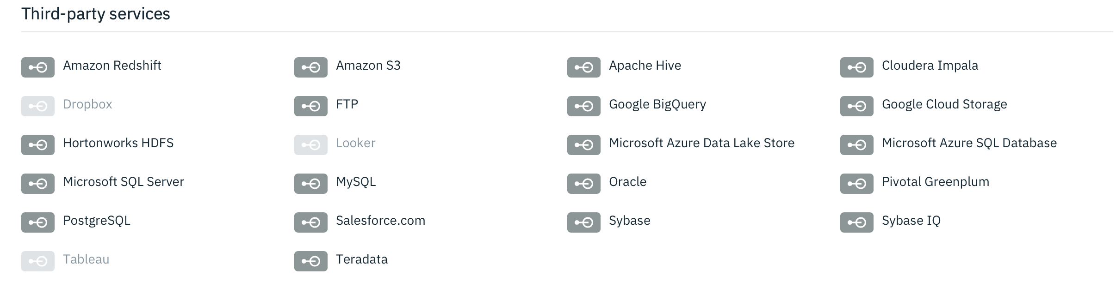
Adding data to Data Refinery
Push Files to Assets Directory (Drag & Drop)
Create connections with IBM or Third Party Storage Services
6

Slide 9
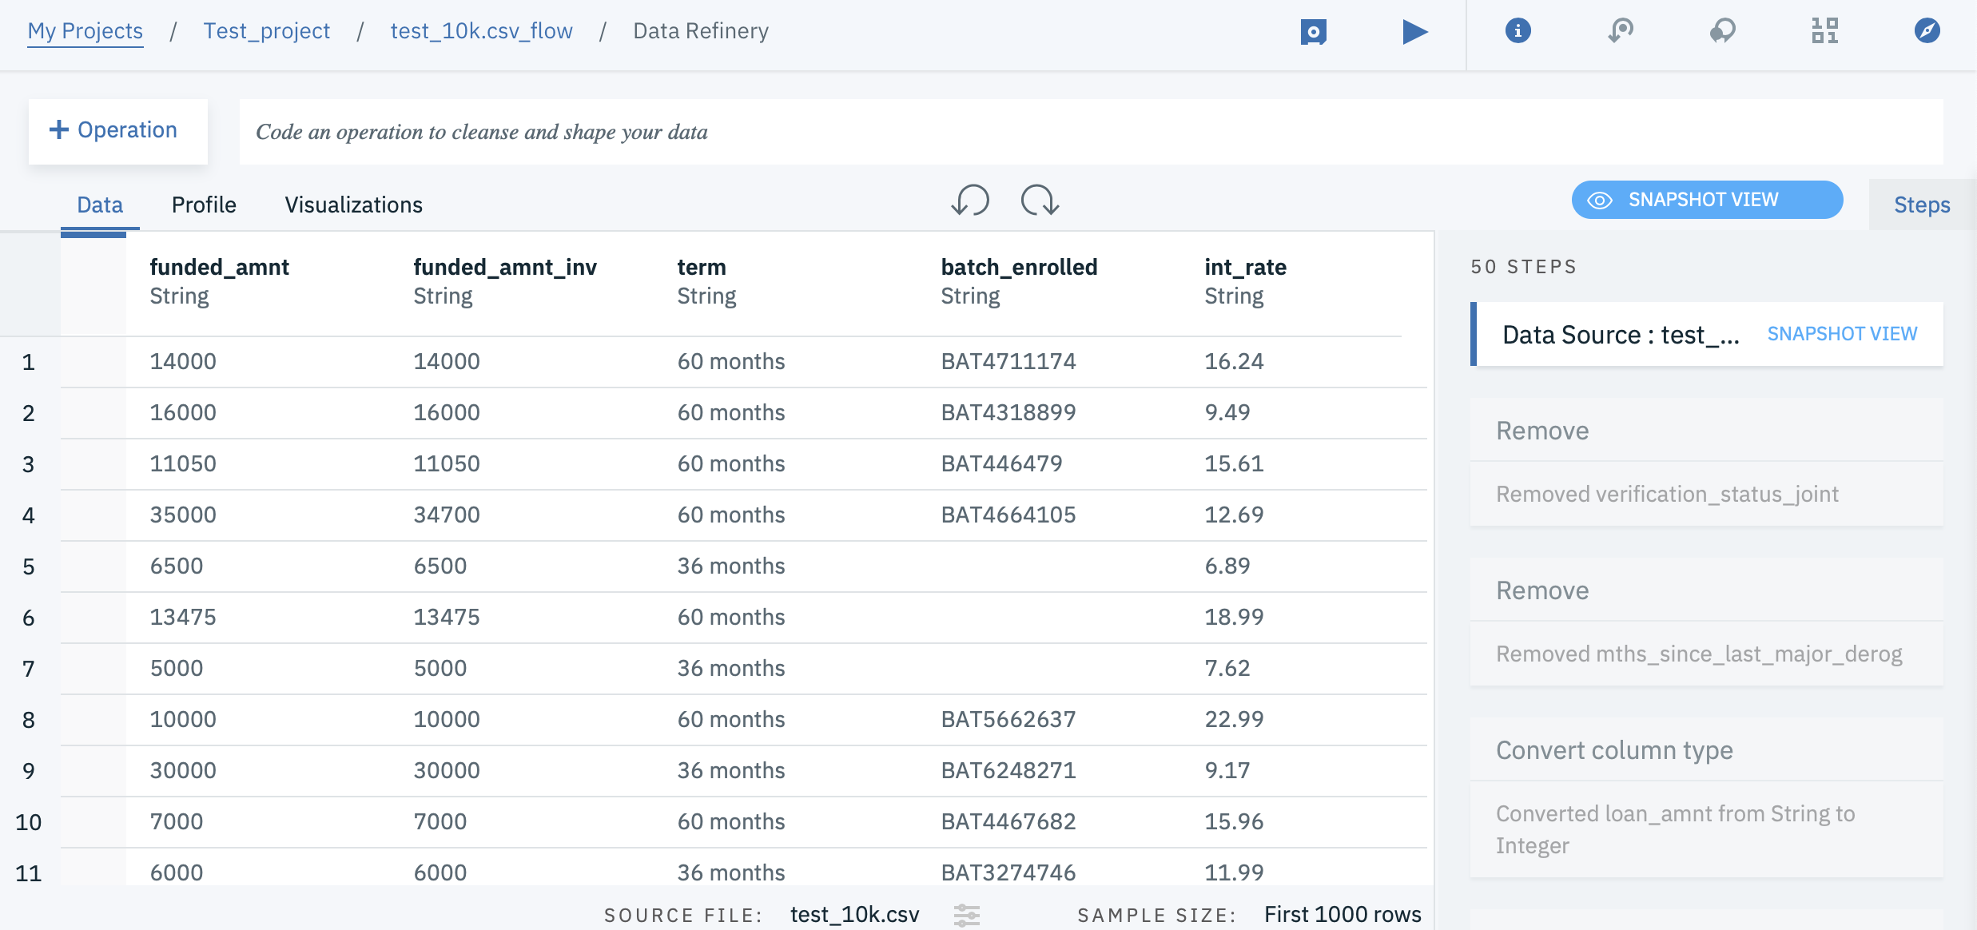
View Sample Data Set
This helps to view the subset of data for exploring the columns and their data formats
7

Slide 10
Validating the Data
Remove unwanted rows for your problem Case
Check the Datatypes of columns and change them according to the data
If required change the column names according to your convenience
Remove the rows of a dataset based on emptiness of columns(based on a threshold of column emptiness)
Mask the Confidential data which cannot be exposed to Data Scientist/Software Engineers
Remove/Replace Unnecessary Characters from the String Columns
Create new columns by applying conditions on two or more columns
8

Slide 11
Validating the Data
Combine two or more columns which can be represented as single feature for better understanding and readability.
Split columns based on the separators(alphanumeric) or patterns or based on position.
Apply Math functions on columns to derive new data/columns from the existing dataset/columns.
Fill the missing values with constant ,mean,min,max,median for integer/decimal columns.
Join the two or more datasets based on the common key columns.
Arrange the dataset in required order based on columns [Ascending/Descending order]
9

Slide 12
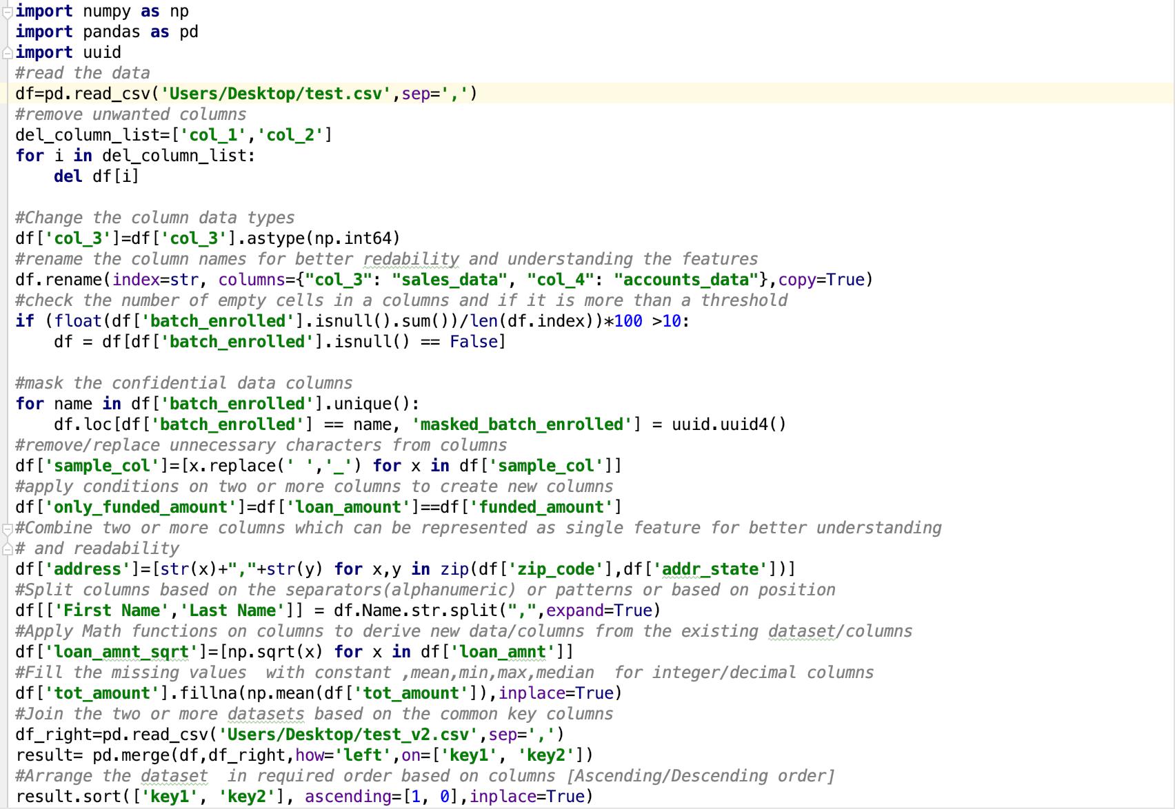
Sample Python Code Snippet:
10

Slide 13
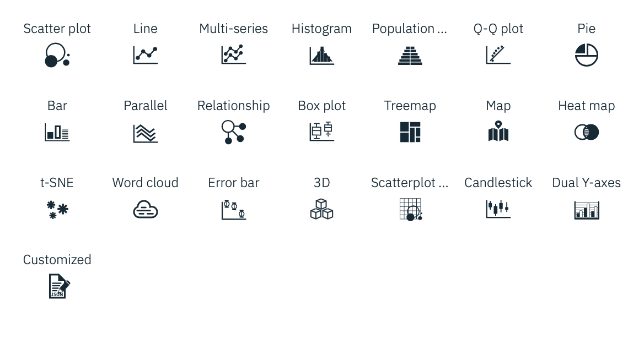
Visualizing the data
Different types of visualization graphs are available in order to view ,analyze and understand the data better
11

Slide 14
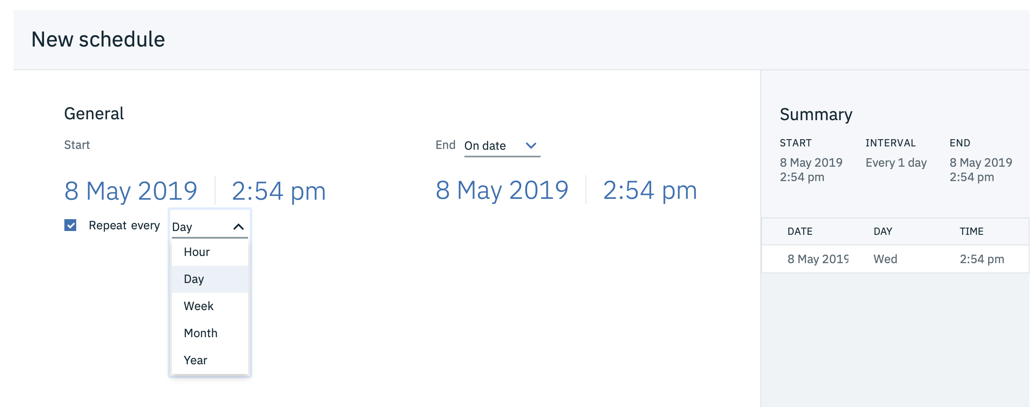
Scheduling Data Refinery Flow
Schedule data refinery flow as jobs(recurring) on the datasets
12

Slide 15
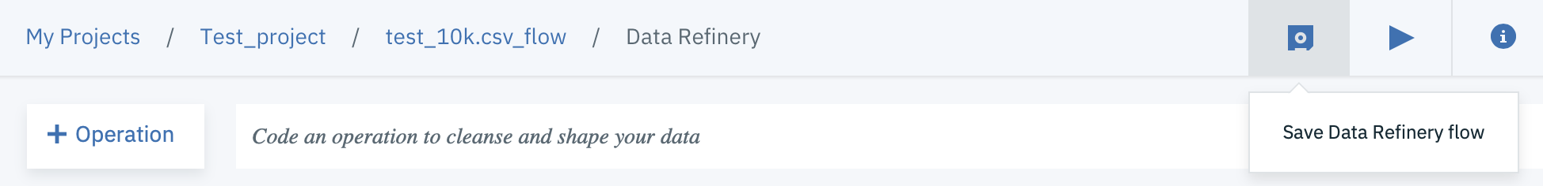
Manage Data Refinery Flow
Save the data refinery flow in Watson studio with a series of cleaning steps
Add/Remove the refinery steps from the data refinery flow
Snapshot view of Data refinery steps
13

Slide 16
Thank you
Naresh Olladapu
Developer Advocate
nolladap@in.ibm.com
+91-8132097165
14

